Slide 1

Environmental Conservation Tracking System
Team 03
Cheril Yogi NUID: 002790646
Nishigandha Patel NUID: 002659174
Ritik Gupta NUID: 002102556
Shweta Khade NUID: 002872604
Somil Shah NUID: 002807855

Slide 2
OBJECTIVE
01
02
03
04
Enhance Conservation Impact
Efficient Resource Management
By providing a comprehensive dataset, the system enables data-driven decisions, enhancing the positive effects on natural resources and wildlife conservation.
Streamline the management and monitoring of wildlife sanctuary data, reducing operational costs and promoting effective resource allocation.
Empower Outreach and Education
Tourist Engagement and Feedback
Support outreach and educational programs, raising public awareness and involvement in environmental conservation efforts.
Incorporate a unique tourist functionality, allowing visitors to track their visit history and provide feedback, thereby enhancing visitor experience and contributing valuable insights for sanctuary improvement.

Slide 3
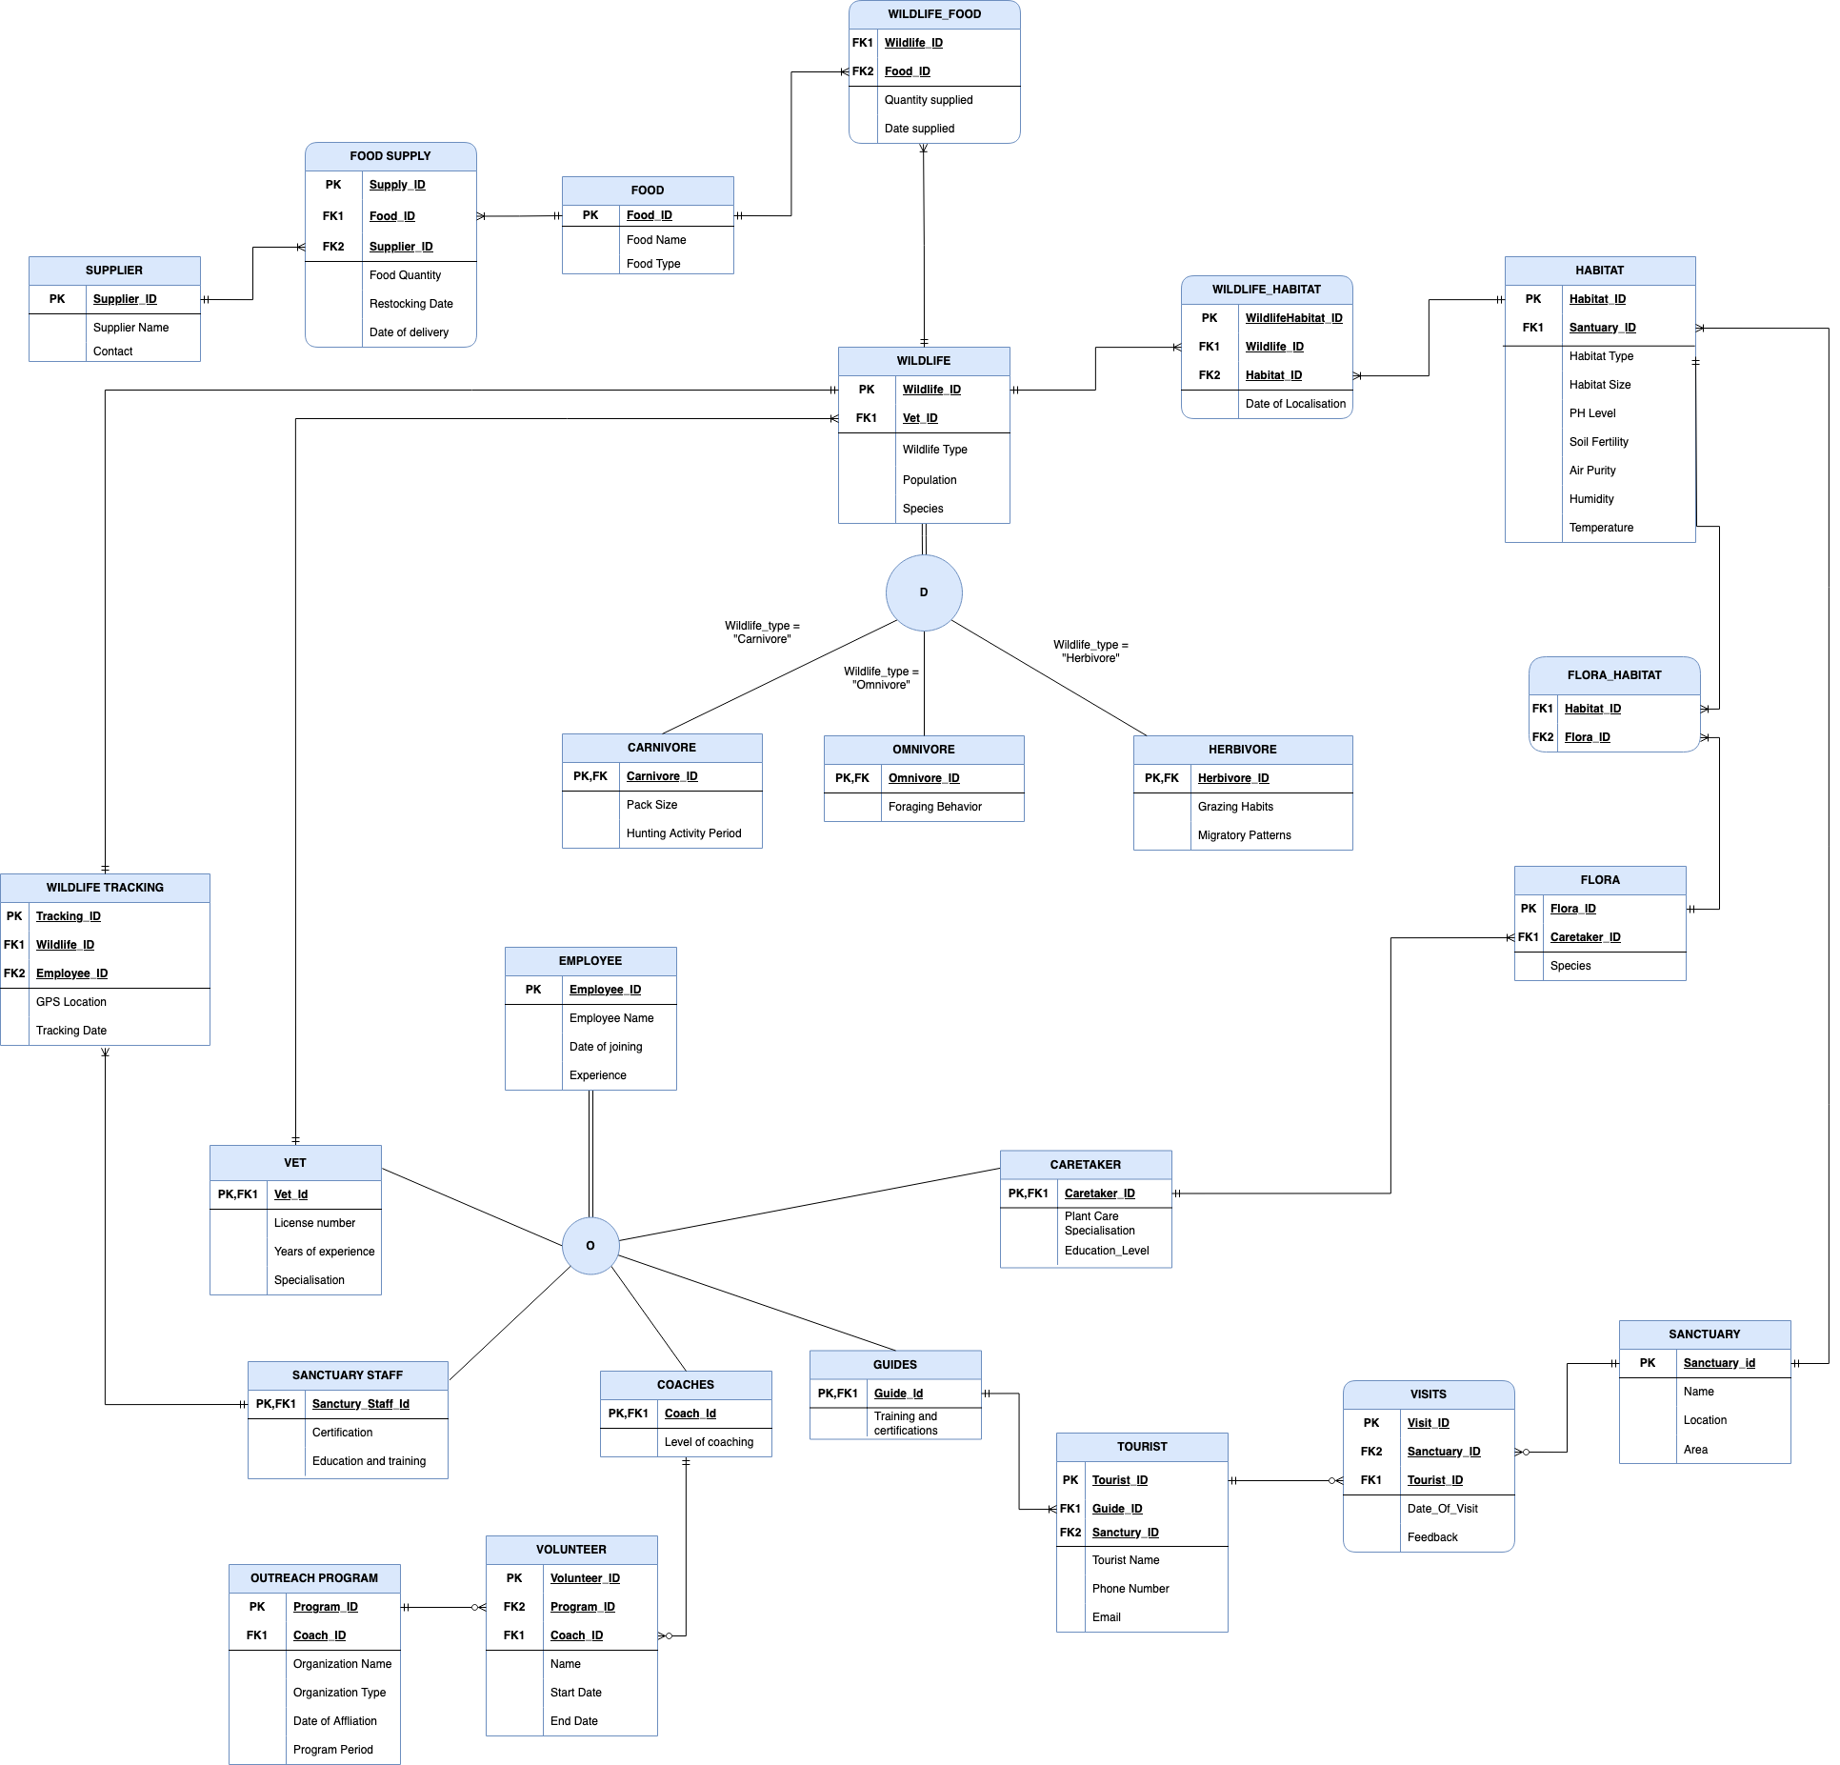
ENTITY RELATIONSHIP DIAGRAM

Slide 4
Database Overview
All About Tables
Stored Procedures
Tables: 24
Computed Columns: 3
Check Constraints: 16
Non-clustered Indexes: 17
Column Data Encryption: 1 (SSN)
Stored Procedures: 3
User Defined Functions
User Defined Functions: 3
Triggers & Views
DML Triggers: 2
Views: 5
Data Visualisation & GUI
Data Visualisation: PowerBI Dashboard
GUI for CRUD Operations (Streamlit)

Slide 5
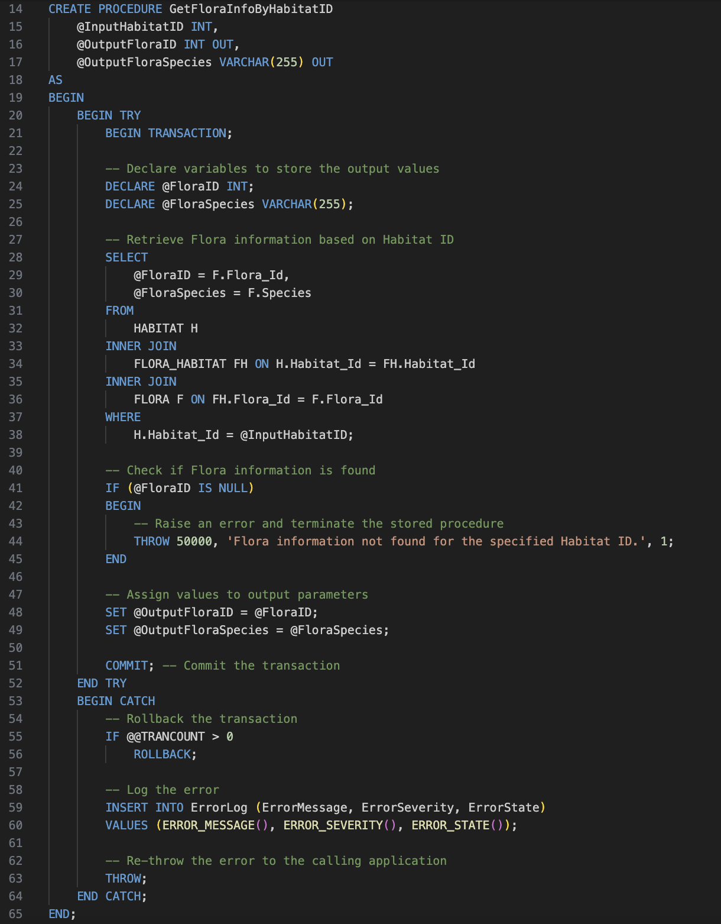
Stored Procedures
01
02
03
Functionalities
GetFloraInfoByHabitatID
Retrieves Flora ID and species for a given Habitat ID, ensuring data accuracy with transaction handling and error logging.
GetWildlifeInfoByHabitatID
Obtains Wildlife ID, species, and type based on Habitat ID, with optional transaction control and detailed error handling.
AddNewTourist
Adds a new tourist to the database, validating Guide and Sanctuary IDs, phone numbers, and email addresses, and confirming successful addition or error occurrence.

Slide 6
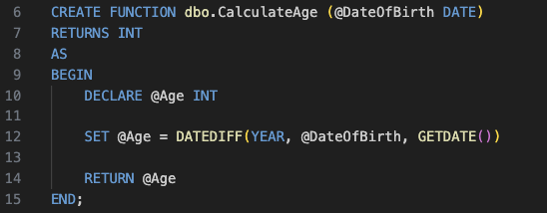
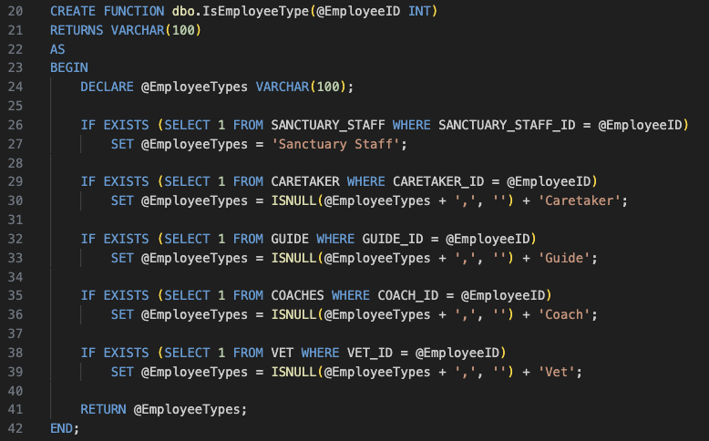
User Defined Functions
01
02
03
Functionalities
dbo.CalculateAge
Calculates an individual's age from their date of birth.
Used in computed column
dbo.IsHabitatSuitable
Determines if a wildlife habitat meets specific environmental standards.Used in Computed column
dbo.EmployeeType
Identifies and categorizes employee roles based on their departmental associations.

Slide 7
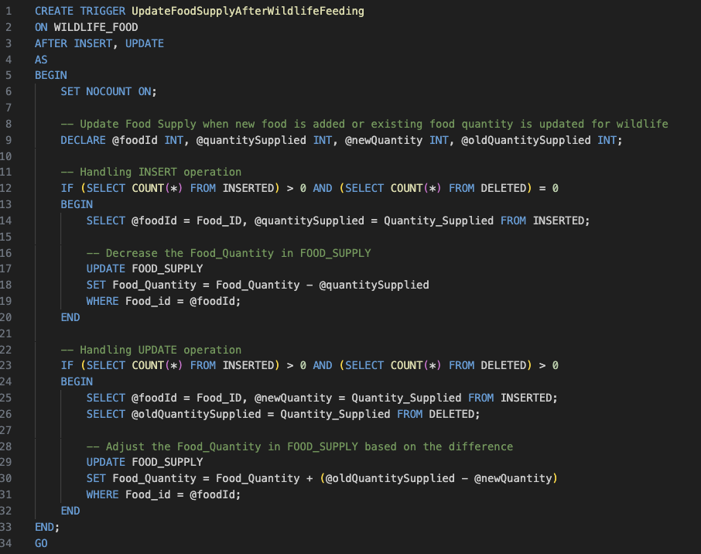
DML Triggers
01
02
Functionalities
Visits
Automatically sets a default feedback message in the VISITS table when new visit records are added without feedback.
UpdateFoodSupplyAfterWildlifeFeeding
Ensures the FOOD_SUPPLY table is accurately updated in response to changes in food supplied to wildlife, recorded in the WILDLIFE_FOOD table.

Slide 8
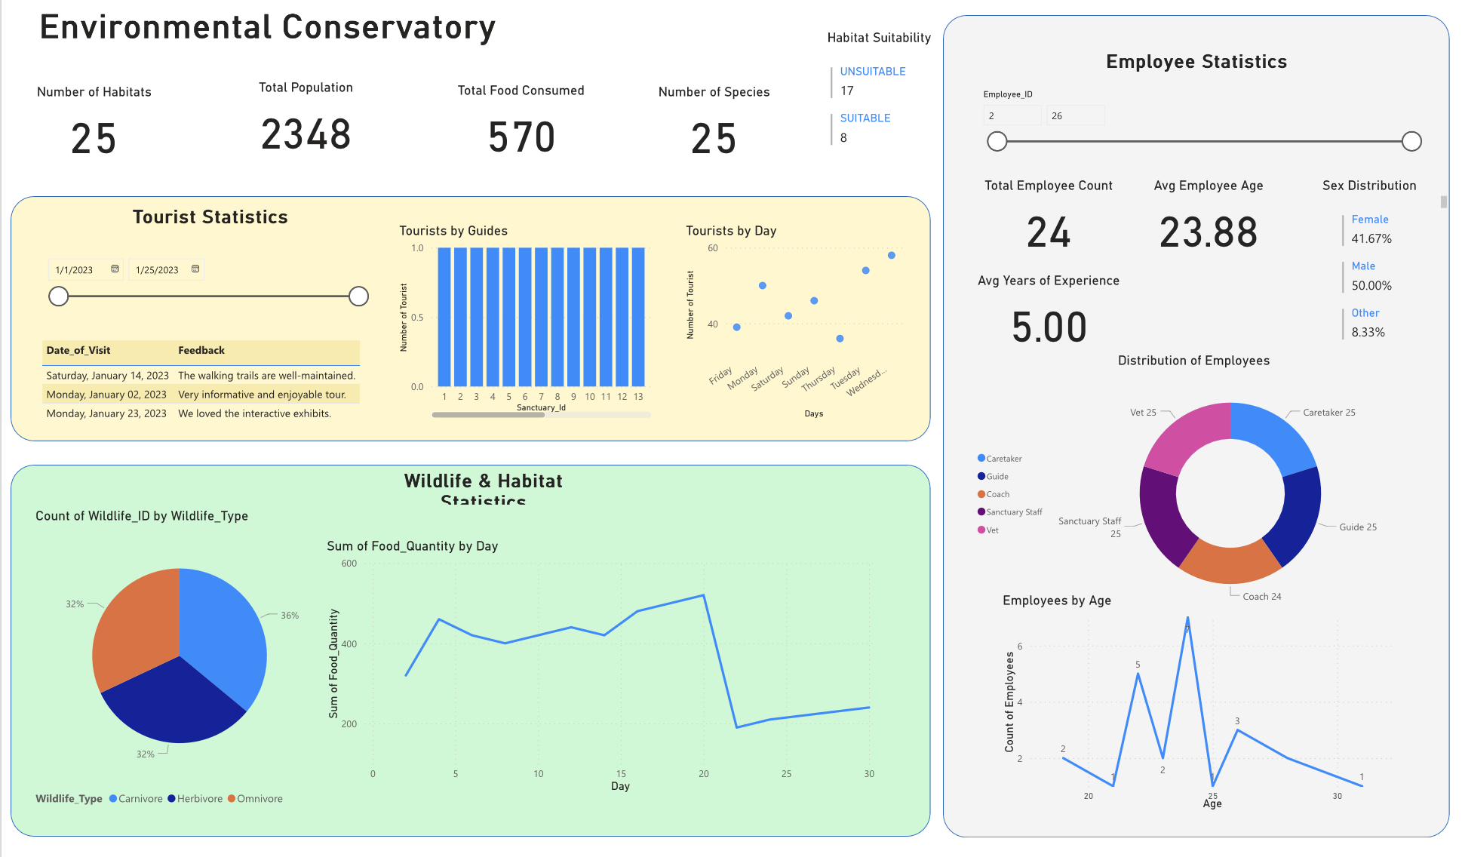
Data Visualization: PowerBI Dashboard

Slide 9
DEMO

Slide 10
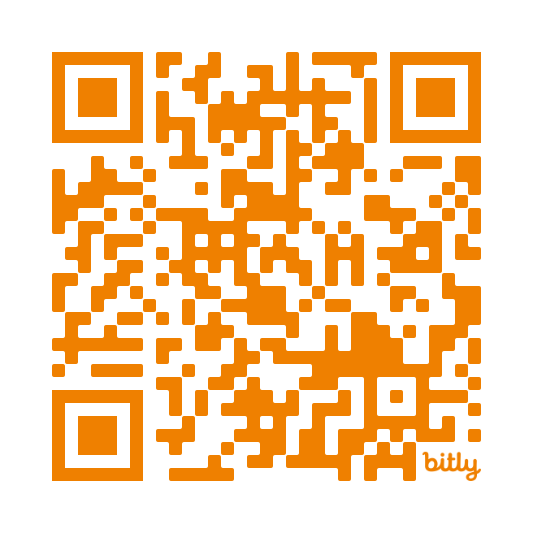
THANKS!
For further information you can refer
the detailed documentation:
http://bit.ly/DMDDGroup3

